Slide 1
ENSE 470: Milestone 3
Team Dancing to Zebras
Tristan Heisler, Demitri Kourles and Zuoxiu Xing
February 1st, 2018

Slide 2
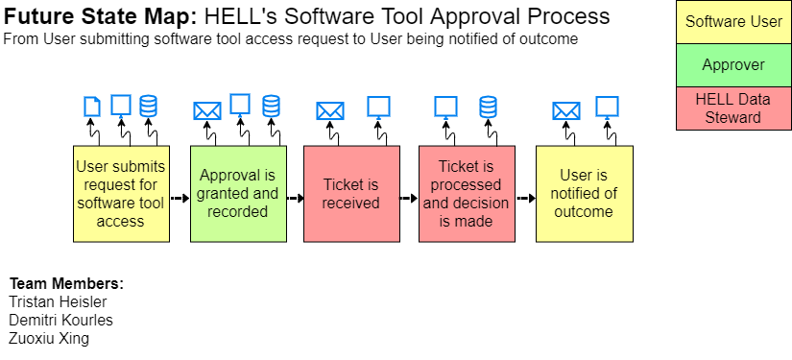

Slide 3
User Stories - Request
Valid Information Enforced - As an analyst, I want the request input form to ensure that valid information has been entered before it can be submitted so that invalid requests cannot be submitted.
Single Request Input Method - As an analyst, I want there to be only a single way to submit a request so that a clear request process can be developed, implemented, followed and enforced.
Approver Contacted Once - As an approver, I want to be contacted only once throughout the request process so that redundant work is avoided and I can dedicate my time to more important tasks.
Informed Approver - As an approver, I want to be able to obtain information about the request so that I can make the appropriate decision for approval or denial.

Slide 4
User Stories – Request (cont.)
Grant Approval - As an approver, I want to be able to approve requests that meet my established requirements so that the ticket can be sent to the analyst for processing.
Deny Approval - As an approver, I want to be able to deny requests that do not meet my standards so that I can ensure that our software tools are only used by people who require them.
Log Into System - As a manager, I want all of my employees to be able to log into the system to perform their associated tasks in the request process so that a central hub is provided for all users and the process is easier to document.
Log Out of System - As a manager, I want all of my employees to be able to log out of the system when their task is completed so that their information remains confidential.

Slide 5
User Stories – Request (cont.)
Confirm Approval - As a data steward, I want to be able to confirm that approval has been granted or denied for the request so that I can perform the appropriate next step in the approval process.
Vet Ticket - As a data steward, I want to be able to obtain information about the software tool request so that I can process the ticket.

Slide 6
User Stories – Documentation
Request Requirements Outlined - As a software user, I want a clear indication of the information that must be provided in a request so that I am less likely to make mistakes when requesting access.
Approver List is Available - As a analyst, I want to be able to refer to a list of approvers so that I can understand who has the authority to approve or deny access to the requested tool.
Single Approver List - As an analyst, I want there to be a single resource describing the list of approvers and their associated tools so that this information is easy to update and reference.

Slide 7
User Stories – Documentation (cont.)
Recorded Process - As an analyst, I want all decisions made throughout the approval process to be properly recorded so that individuals do not need to be unnecessarily contacted additional times.
Observe Current State - As a user, I want to be able to see the current state of my request at any time so that I can adjust my expectations and upcoming work accordingly.
Sorted Approver List - As an analyst, I want the approval list to be sorted by software tool name so that excess time is not wasted searching through the document.

Slide 8
User Stories – Notification
Approver Notification - As an approver, I want to be notified when a new request has been made for a tool under my domain so that I can respond to it promptly.
Analyst Notification - As an analyst, I want to be notified when a request has been approved so that I can promptly process the ticket and make the final decision.
User Notification - As a user, I want to be notified when the request has been approved or denied so that I can begin using the software or discover why I was denied access.

Slide 9
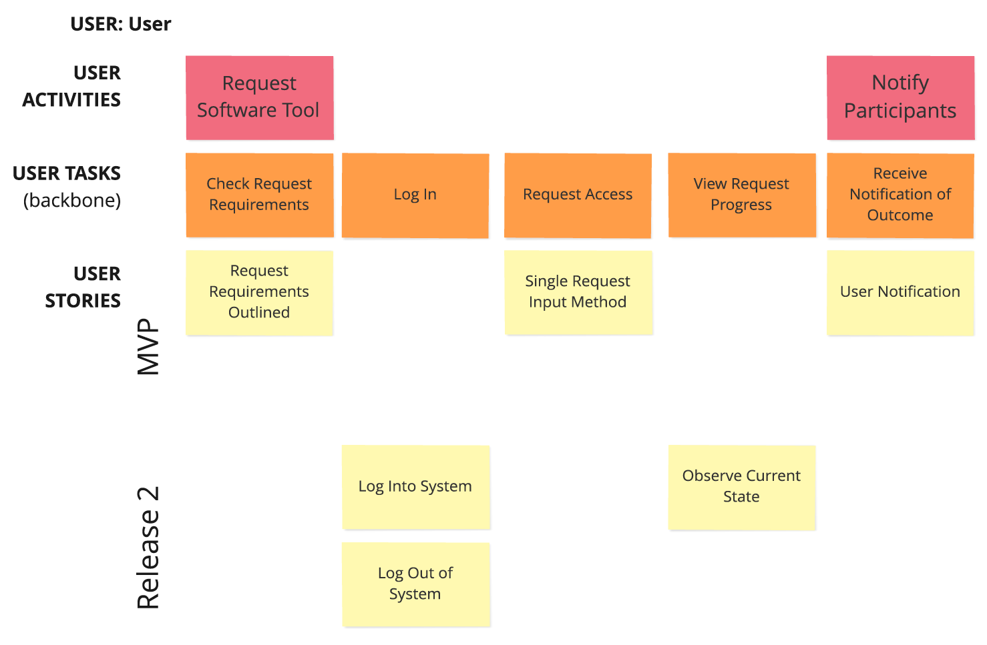

Slide 10
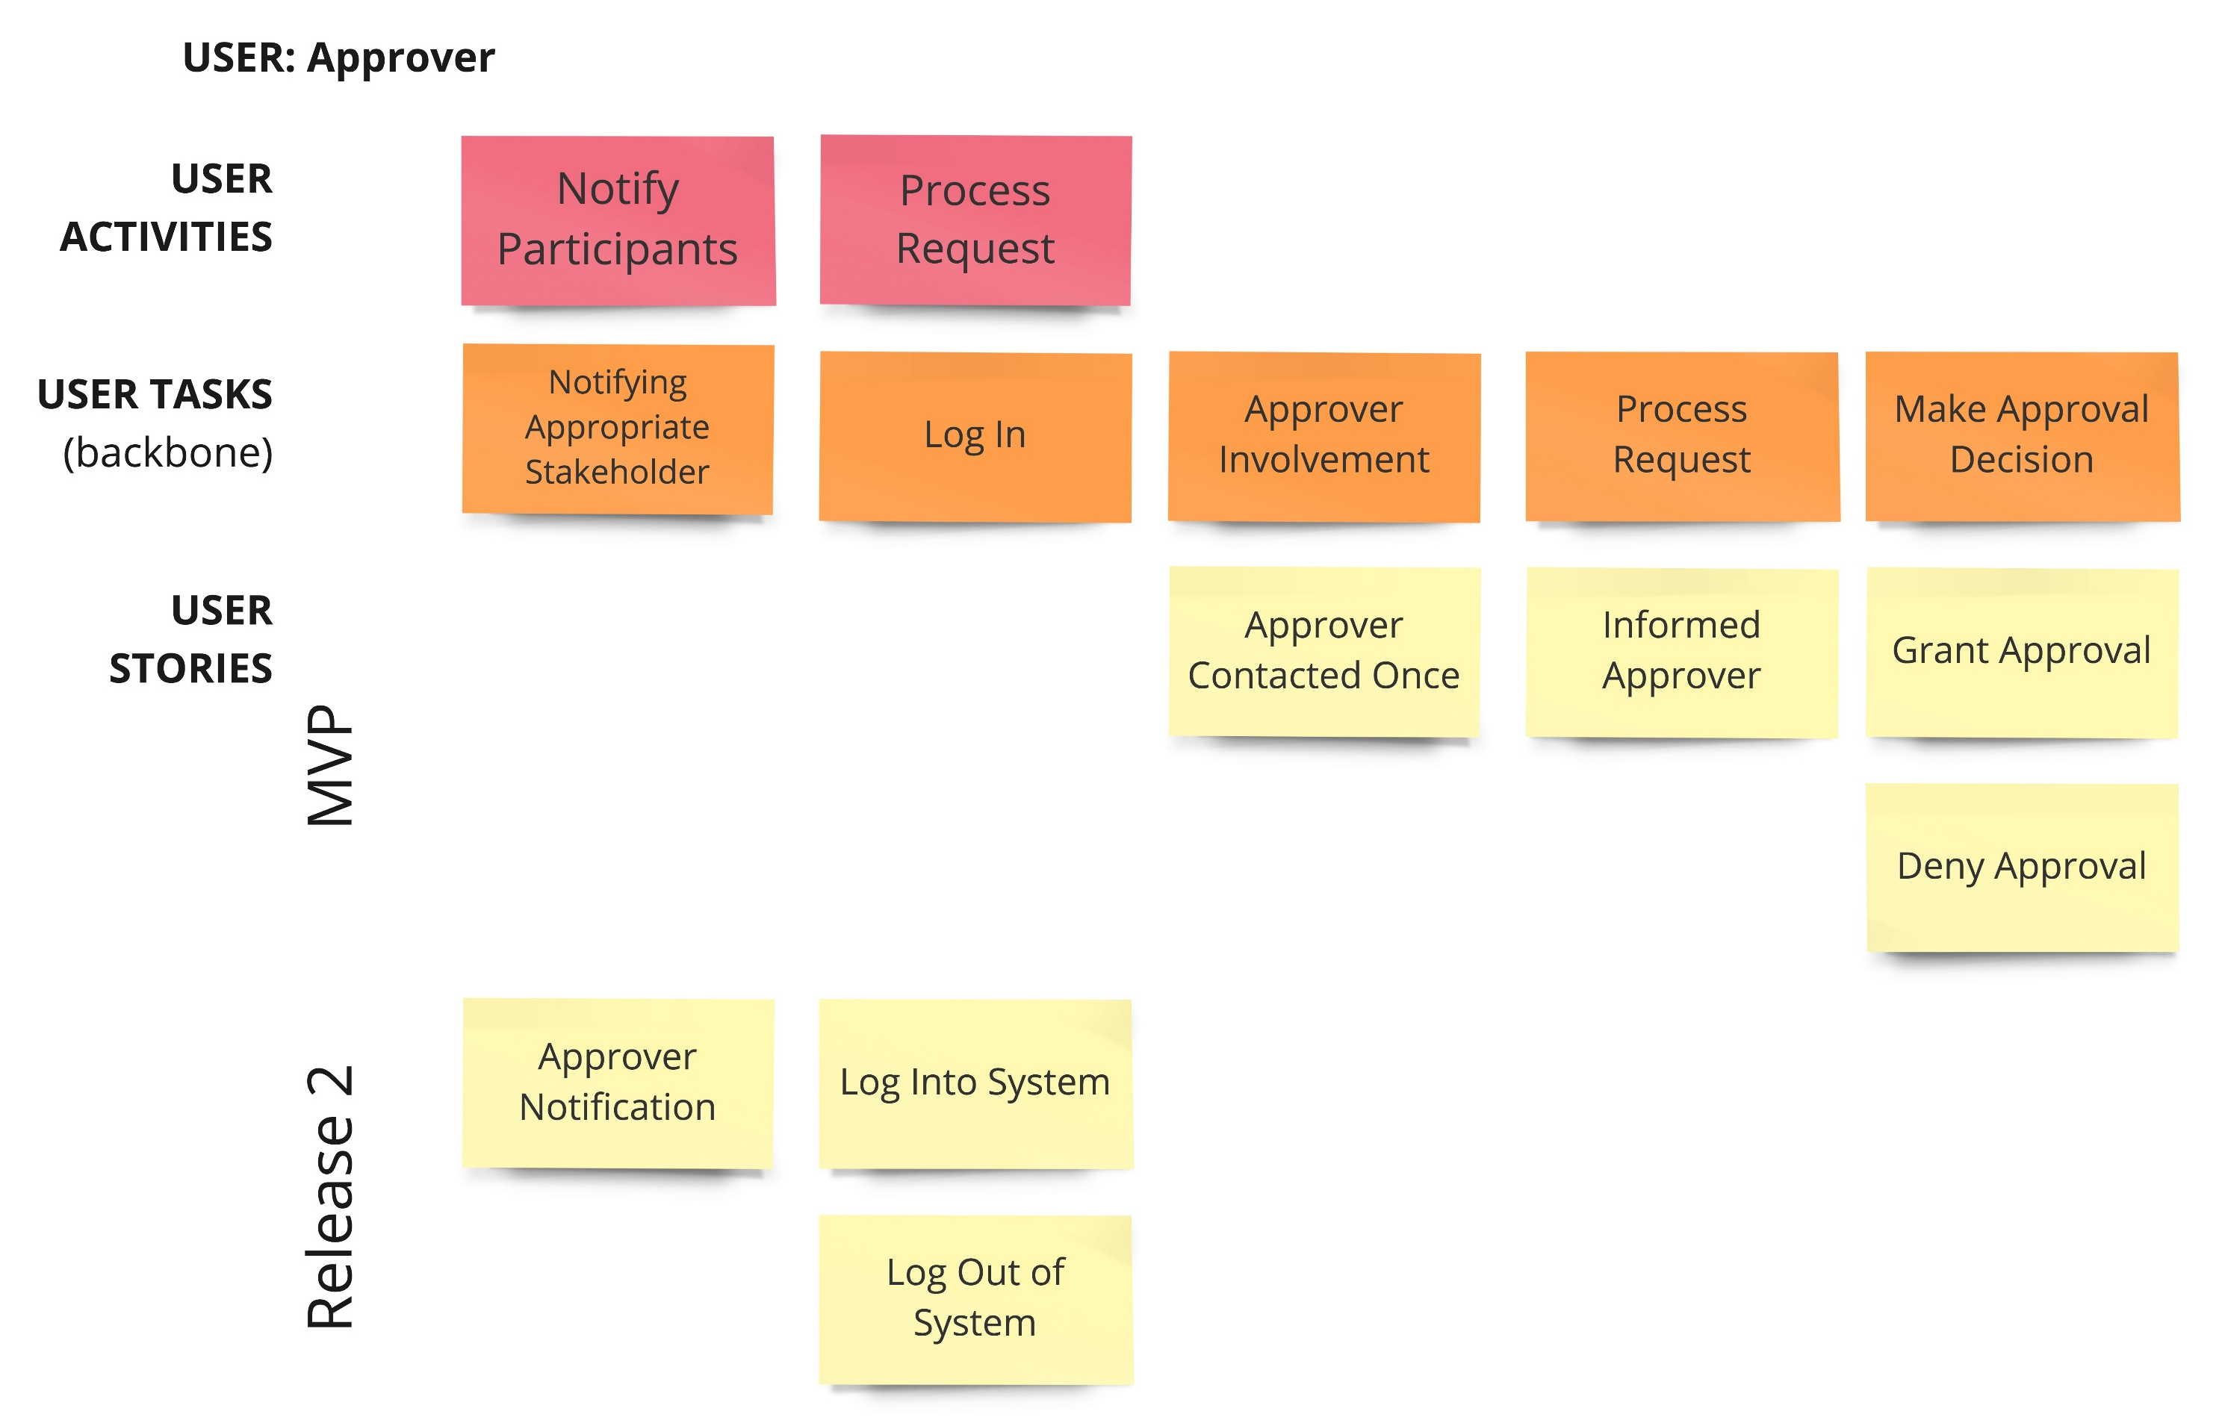

Slide 11
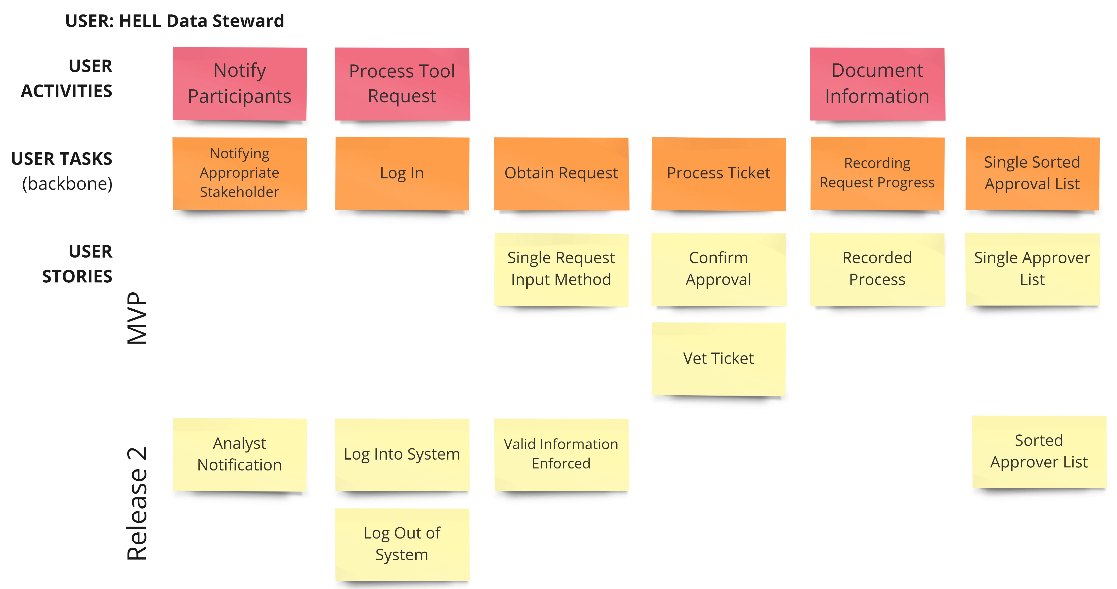

Slide 12
Changes
Have your plans changed since your group’s initial conception and project evolution?
We realized that the user doesn’t truly need to know who the approvers for a given software tool are. Rather, they can simply request access to the tool and the appropriate approvers will be contacted automatically.
Some previously assumed interactions (such as approving or denying access) are now explicitly listed as features.
We believe that a well-thought out future state VSM that has been presented to and reviewed by clients results in a minimum amount of changes required when producing the user story map.

Slide 13
Group Reflection
How did you feel about this milestone? What did you like about it? What did you dislike?
We enjoyed how the final user story maps reveals how each actor expects to be able to interact with the system.
What did you learn about yourself as you collaborated and worked through this milestone?
We discovered that developing individual user story maps for each actor allows us to better understand their requirements of the system.
How will you use what you have learned going forward?
In this project, the developed user stories will turn into features that must be implemented. In our future careers, the user story maps could be presented to the appropriate stakeholders to confirm that we understand the desired process.
What “stuff & things” related to this milestone would you want help with?
Initially, we did not realize that a user story map was intended to be produced for a single user.

Slide 14
Questions?

